Slide 1
Statistical Machine Learning vs. Deep Learning: Performance and Application in Healthcare
Sean Anderson, Eli Shtindler, Christopher Spadavecchia

Slide 2
Agenda
Introduction
Tabular Dataset and Models
Image Dataset and Models
Results
Conclusion
Notes:
chris

Slide 3
Introduction
Objective: Compare the effectiveness of machine learning vs. deep learning in healthcare applications.
Context: AI is transforming diagnostics, treatment, and patient care in healthcare.
Approach:
Traditional ML models: Decision Trees, Random Forests, SVM
Deep learning: Neural Networks
Notes:
sean

Slide 4
Introduction
Datasets
Image dataset for pneumonia detection
Tabular dataset for diabetes prediction
Evaluation Metrics
Accuracy
Precision
Recall
F1 Score
Goal: Identify which model type works best for different data structures to guide future healthcare AI development.
Notes:
sean

Slide 5
Diabetes Prediction Dataset
Comprehensive Dataset: Combines medical and demographic data to facilitate diabetes prediction.
Key Features: Age, Gender, BMI, Hypertension, Heart Disease, Smoking History, HbA1c Level, Blood Glucose Level
Target Variable: Indicates whether the individual has diabetes (positive) or not (negative).
Preprocessing involves converting categorical data to one-hot encodings
Encoded Categories: Gender and Smoking History
Notes:
chris

Slide 6
Statistical Model: Decision Tree/Random Forest
Handles both numerical and categorical features without requiring scaling or encoding.
Captures non-linear relationships by recursively splitting the data based on feature values.
Highly interpretable and explainable - the model can be visualized and understood as a set of simple rules.
Performs well on structured/tabular data, especially when feature interactions are important.
Notes:
chris

Slide 7
Deep Learning Model:
Feed Forward Neural Network (FNN)
Learns complex, non-linear relationships that simpler models might miss.
Can automatically learn feature interactions without manual engineering.
Highly flexible architecture - the number of layers and neurons can be tuned to match dataset complexity.
Scales well with large datasets, where deep learning's representational power becomes advantageous.
Notes:
sean

Slide 8
Chest X-Ray Images Dataset
Comprised of 5,856 chest X-ray images categorized into two classes: "Pneumonia" and "Normal".
Organized into training, validation, and test sets, facilitating model development and evaluation.
Primarily contains pediatric chest X-rays, making it particularly relevant for studies on childhood pneumonia.
Images are in JPEG format, suitable for use with various image processing and deep learning frameworks.
Very little preprocessing is needed, just channing pixel values from 0-255 to 0-1.
Notes:
eli

Slide 9
Statistical Model:
Support Vector Machine (SVM)
Effective in high-dimensional spaces, like flattened image vectors with thousands of pixels.
Works well for binary image classification tasks, especially when the dataset is small or medium-sized.
Robust to overfitting, particularly with the right kernel and regularization settings.
Kernel trick enables non-linear classification, useful for capturing complex patterns in image data.
Maximizes the margin between classes, often leading to better generalization.
Notes:
eli

Slide 10
Deep Learning Model:
Convolutional Neural Network (CNN)
Automatically learns spatial hierarchies of features—from edges to textures to objects.
Preserves spatial relationships between pixels through local receptive fields (convolutions).
Parameter-efficient, thanks to weight sharing in convolutional layers (fewer parameters than fully connected networks).
Translation-invariant, meaning it can recognize patterns regardless of their position in the image.
Captures local patterns such as edges, corners, and textures—key elements in visual recognition.
Notes:
eli

Slide 11
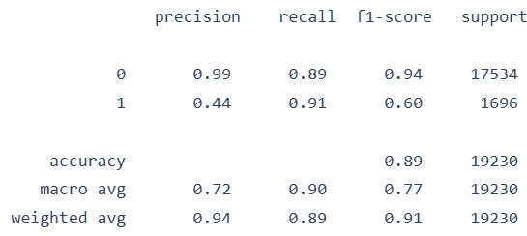
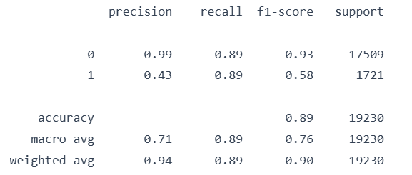
Tabular Dataset Results
Decision Tree:
FNN:
Both models achieved 89% accuracy, showing similar overall performance.
Decision Tree had higher recall (0.91 vs. 0.89) for the positive class, making it slightly better at detecting true positives.
Both models had low precision for the positive class (≈0.44), indicating a high false positive rate.
F1-scores for the positive class were slightly higher in the Decision Tree (0.60) than in the FNN (0.58).
Decision Tree is more interpretable, which is valuable in clinical decision-making without sacrificing performance.
Notes:
Chris and sean

Slide 12
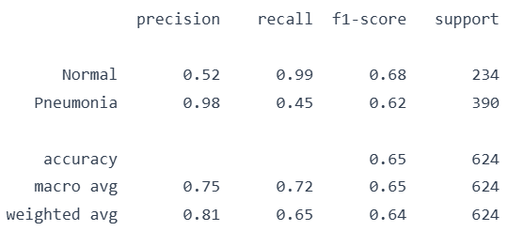
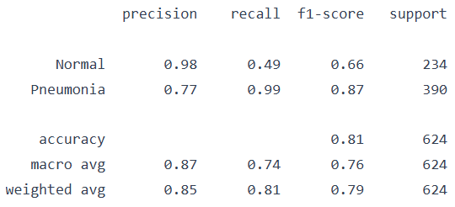
Image Dataset Results
SVM:
CNN:
CNN achieved higher accuracy (81%) compared to SVM’s 65%, indicating better overall performance.
CNN had much higher recall for Pneumonia (0.99 vs. 0.45), making it far more reliable for detecting actual disease cases.
SVM had higher recall for Normal cases (0.99 vs. 0.49), but this came at the cost of missing many pneumonia cases.
CNN showed better F1-score for Pneumonia (0.87) compared to SVM’s 0.62, reflecting superior balance between precision and recall.
CNN is better suited for image data due to its ability to learn spatial features, while SVM flattens images, losing spatial context.
Notes:
eli

Slide 13
Future Work
Broader Datasets:
Include multi-class, time-series, and EHR-based data for deeper clinical context.
Stronger Models:
Use advanced DL (ResNet, Inception) and ensemble ML (XGBoost, LightGBM).
Interpretability:
Apply SHAP/LIME to boost model transparency and trust.
Fairness:
Evaluate demographic bias and apply fairness metrics.
Collaboration:
Involve healthcare professionals throughout development.
Notes:
eli

Slide 14
Conclusion
Findings:
ML (Decision Tree/Random Forest) performed best on tabular diabetes data.
DL (CNN) outperformed ML on pneumonia image data.
Key Insights:
Data structure strongly influences model performance.
Preprocessing (e.g., encoding, normalization) is critical for success.
Choosing meaningful, clinically relevant features is essential.
Notes:
sean

Slide 15
Thank You

